Slide 1
ReactJS Training
Day 9

Slide 2
Topics
Using Radium for Media Queries
Introducing Styled Components
More on Styled Components
Styled Components & Dynamic Styles
Working with CSS Modules
CSS Modules & Media Queries

Slide 3
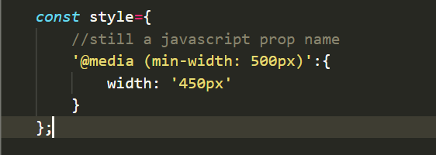
Using Radium for Media Queries
We can also use radium to use media queries.
Add a new style with constant and use a special selector.
Assign the style to the DIV : <div className="Person" style={style}>
We need to wrap our entire application in a style root component.
in App.js : import Radium, { StyleRoot } from 'radium';
Wrap return statement with <StyleRoot></StyleRoot>

Slide 4
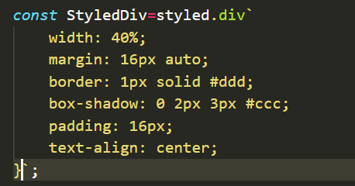
Introducing Styled Components
Very popular package and third party library is styled components.
Styling components and making that very simple.
https://styled-components.com/
Installation - npm install --save styled-components
import styled from 'styled-components';

Slide 5
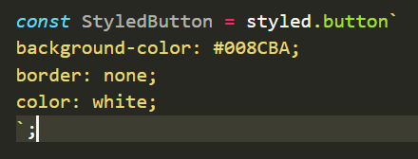
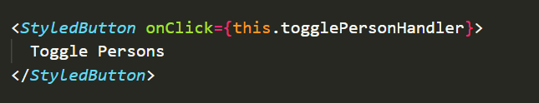
More on Styled Components
CSS class names are automatically added by the styled components library.
Content of this class coming from head section of this document.
Let's add styled components in app.js
import styled from 'styled-components';

Slide 6
Styled Components & Dynamic Styles
We change styles conditionally using styled components.
We can just pass a prop to a button. E.g: alt (any name can be given)
<StyledButton alt={this.state.showPersons} >
we can dynamically inject content though with a special syntax.
background-color: ${props => props.alt ? 'red' : 'green'};
It will swap these classes based on our condition.

Slide 7
Working with CSS Modules
CSS file scoped to a certain a certain component.
We should have css and javascript in separate files.
For CSS Module to work, we need to tweak the configuration of our project a little bit.
We need to tweak the configuration if we're using react scripts version
"react-scripts": "1.0.13“
If you are using react scripts version 2 or higher you have an alternative approach of enabling this feature

Slide 8
Working with CSS Modules
Run this command => npm run eject
If we are using Git we will get error =>Remove untracked files, stash or commit any changes, and try again .
Resolve git error with commit or stash changes and re run npm run eject again.
So then we will get new config folder, These are the configuration files which are used under the hood by this react tooling.
You'll see the package.Json also changed. We have way more packages here now.
In webpack.config.dev.js scroll down and find test: /\.css$/ and under option add following
modules: true,
localIdentName: '[name]__[local]__[hash:base64:5]'

Slide 9
Working with CSS Modules
Do same in a webpack.config.prod.js file.
Now in App.js => import cssclass from './App.css';
Use css from the import now.
<div className={cssclass.App}>
<button className={cssclass.button} >
classes.push(classes.red);
Transforms every class name here to a random unique one and returns us a map of these generated unique class names.

Slide 10
CSS Modules & Media Queries
If you are using react scripts version 2.x or higher you have an alternative approach of enabling this feature
Rename our css file to => Person.module.css
Import from .module => import classes from './Person.module.css';
This will automatically work without ejecting.

Slide 11


